Slide 1
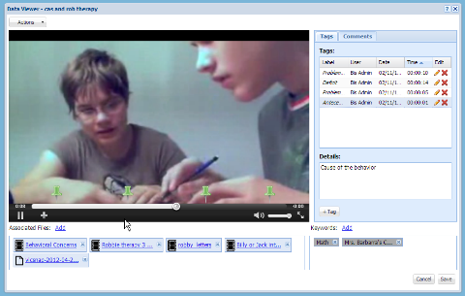
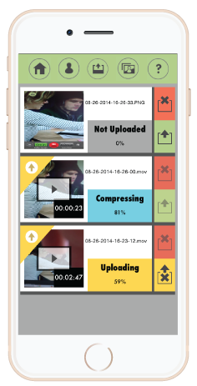
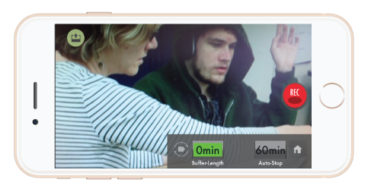
Feasibility of Conducting FBA’s in the Schools with Web-Based
Video Recording Technology
Peyton L. Groff ^{1,2,3}, Dana Zavatkay ^{1,2,3}, Jason T. Calvin ⁴, Ronald Oberleitner ⁵, Dianna Briggs^{1,2,} & Carol Crothers ⁵
Marcus Autism Center¹, Children’s Healthcare of Atlanta², Emory University School of Medicine³, Center for Leadership and Disability⁴, Behavior Imaging⁵
Introduction
procedures continued…
Data Analysis:
Efficacy of web-based video recording FBA’s
Evaluation of the ability to determine observe and hypothesize function of target behaviors
Social validity scores from teachers and consultants compared
Comparison of web-based to traditional FBA regarding cost-benefit
Using study’s time logs and archival billing records, comparison of average time spent by clinicians were compared
Economic analysis done to compare estimated cost of web-based video vs. traditional FBA
results continued….
Cost-Benefit of Web-Based Video FBA in Relation to Traditional Assessment
Comparison of the web-based video recording to archival traditional FBA assessments demonstrated a 42% savings in clinician time for web-based video procedures.
Hours of formal observation and travel were the domains of greatest savings when comparing to traditional FBA’s
Financial savings to school system for web-based video was on average 39% or $1,533 when compared with traditional approach. Cost based on an hourly clinician rate of $155.00, travel rate of $77.5, and 0.575 per mile.
Areas of greatest savings for web-based procedures occurred in comparison of travel, mileage, and number of hours of clinical observations.
Direct observation of students remains the gold standard in diagnosis, assessment, and treatment for children with autism (ASD) and related developmental disabilities (Flilpek et al., 1999).
In poor and rural communities, care of children with ASD is marked by lack of access to expertise professionals (Marcin et al., 2004). Even in urban communities, timely access to diagnostic and intervention services is often hampered by long waiting lists at centers and clinics (Hayden, 2011).
Despite growing recognition of the potential for Behavior Imaging to improve access to care for individuals with ASD, few peer-reviewed evaluations of this kind of telehealth applied to ASD have been published (Gallagher, 2004). Additional information is needed in a number of areas including:
Better sense of technology requirements for assessment and treatment procedures
Comparison of services delivered via Behavior Imaging vs. traditional in-person services
The clinical efficacy and cost-benefit of using Behavior Imaging in the school setting
Purpose of Current Study:
To determine the efficacy of using web-based video recording technology to conduct functional behavioral assessments (FBA’s) in the schools for children with ASD or related disorders.
Explore the cost-benefit (i.e., time and money) of using Behavior Imaging for FBA’s in the schools when compared to archival records of FBA’s conducted in person (i.e., traditional approach).
Results
Utility of Using Web-based Video Technology for FBA’s:
Teachers were able to collected on average nearly 1 hour of video across 3.2 days of school with a typical video lasting approximately 7 minutes (range 1:09 to 13:00). Across all students 76.8% of the videos contained at least one target problem behavior.
Clinicians were able to hypothesize the function for at least one target problem behavior for 100% of the students. Of the video types requested by the clinician, 90% were able to be collected at least once by the participating teachers.
DRA has offered to help us maximize this recognition around the time of this award.
Method
Student | # Videos | # of Video's with Target Bx | Avg. Time of Video (min) | Total Length (min) | Days of Video | Functional Hypotheses Obtained?
1 | 11 | 6 | 7.35 | 80.93 | 5 | Yes
2 | 6 | 6 | 10.48 | 62.85 | 3 | Yes
3 | 4 | 3 | 8.57 | 34.33 | 2 | Yes
4 | 7 | 6 | 5.16 | 57.16 | 2 | Yes
5 | 6 | 5 | 3.24 | 38.84 | 4 | Yes
Participants & Setting:
Five students (ages 7-13) and their respected teachers (4 special education instructors) completed all steps of the assessment. A total of 9 schools completed the initial consent but 4 participating schools dropped (e.g., student moved, technology issues by teacher, no teacher follow through)
Students varied in Special Education ruling (ASD, OHI, MOID)
All students were in either self contained or ASD based classrooms
Two consultants (1 PhD, 1 BCBA) served as the clinician who completed all clinical duties necessary for development of FBA report.
Procedures
Video Training and Equipment Use:
Teachers were sent Behavior Imaging equipment (on smartphone) and
received 30-60 min training via videoconference technology
Functional Behavioral Assessment
Clinicians conducted initial interview to review target
problem behaviors and type of videos to record
Teachers recorded video of target problem behaviors
and uploaded them to Behavior Connect™ website
Videos were viewed, analyzed, and tagged by clinician.
Interactive website allowed for feedback, labeling of
function, and treatment recs between parties
Efficacy and Cost Analysis
Teachers and clinicians kept time logs of duties throughout process
Teachers and clinicians completed a 10 item social validity measure regarding usefulness of technology and procedures
Archival data from 24 traditional (in person) FBA’s from Marcus’s School Consultation Program from 2009 – Present were collected with regards to billing for cost/time comparison
With regards to social validity, clinicians gave an average overall rating of 4.02 / 5 across the 10 item survey. Highest average scores were with regards to the willingness to use the web-based procedures in the future, their favorability of the web-based procedures, and the ease at which functions could be identified (all 4.4. out of 5).
Teachers scores on the social validity measure were on average slightly lower than clinicians’ scores, with an overall average rating of 3.45 / 5. Highest rated items included acceptability of web-based procedures, willingness to use procedures again, and favorability of the procedures (all 4.0 out of 5). Technology ease, confidence in behavioral change, and preference over traditional assessment approaches were identified as neutral or slightly negative.
Discussion
Overall, clinicians were able to successfully use the web-based video recording equipment to record problem behavior and develop functional hypotheses for all 5 students.
Social validity showed that clinicians preferred the web-based procedures to a greater degree than teachers. Teachers noted concerns with ease of technology. Time logs also revealed challenges with regards to consent process for videos.
Significant cost-benefits were found with regards to both consultants time and financial savings to the school, both at approximately 40%. Travel cost and reduction in amount of hours of observation to obtain appropriate data appeared to be the areas of greatest savings.
Limitations
Little is known about the cost in time to teachers with this approach regarding training, use of equipment, and overall impact on student outcomes.
Comparison of approaches was based on archival and not use of both assessments for the same students or match controls.
Future Directions
Further evidence is needed as to the degree of difference (if any) between approaches with regards to clinical findings (e.g., function, rate, and frequency of problem behavior).
Investigation into how such web-based procedures could assist with follow-up intervention.
* Item reversed scored for total score average

